Slide 1
Relational Table design from EER diagrams (Mapping from EER to Relational Model)
Principles for table design
From information capture pt. of view
From systems (space,time efficiency) and programming effort point of view
Rules for table design start from 1 and then are refined using 2.

Slide 2
I. Modeling desires
Any information that can be recorded in the conceptual (EER) model about: individual entities, their relationships, membership in classes, must be captured in the tables.
EER diagram specifies
domain and range of relationship (thus detecting errors when the relationship is applied to wrong kind of individuals)
domain of attributes (thus detecting errors when an attribute is applied to the wrong kind of entity)
subclasses (thus requiring ability to recognize when an individual is/is not in any of them)
(the combination 3&1 and 3&2 may be particularly relevant (if B is-a A, does R relate A’s or B’s? If B is-a A, and attribute p is introduced on B, should it have values on A-B objects?)

Slide 3
I. Modeling desires (cont’d)
Any information that can be recorded in the conceptual (EER) model about: individual entities, their relationships, membership in classes, must be captured in the tables.
EER diagram expresses additional constraints:
instance of subclass must be an instance of superclass
cover and/or disjoint constraints on subclasses
participation cardinality constraints in relationship
The above can all be accommodated by 1 rule
Create a separate table for every entity and
relationship appearing in the EER diagram.

Slide 4
Recall: what we can/want to say in a table declaration:
list of columns (and their datatype)
PRIMARY KEY (other candidate keys become UNIQUE )
FOREIGN KEY references
NOT NULL constraints
(other constraints stated as CHECK or triggers – to come)

Slide 5
Interlude
Consider the following two Datalog “schemas” and ways to express the query “find names & salaries of employees working in accounting”
e.g.1 employee1(eid,name,salary)
worksIn(eid,deptName)
q1(Name,Salary) :- employee(Eid,Name,Salary),
worksIn(Eid, “accounting”)
e.g.2 employee2(eid,name,salary,worksInDept)
q2(Name,Salary) :- employee2(_,Name, Salary, “accounting”)

Slide 6
(Terminology for queries)
Repeated use of the same variable in multiple tables (on RHS) is called a “JOIN”
uery: “find names & salaries of employees working in accounting”
q1(Name,Salary) :- employee(Eid,Name,Salary),
worksIn(Eid, “accounting”)
q2(Name,Salary) :- employee2(_,Name, Salary, “accounting”)
Using a constant in a column is called a “SELECTION”
Choosing a subset of table columns to show in the answer is called “PROJECTION”

Slide 7
II. Implementation desires
Having fewer tables in a schema, which are the join of other tables, is better because
it makes it easier for the programmer to write queries
queries can be evaluated more efficiently (no “joins”)
(takes less space by eliminating duplicates)
e.g. employee1(eid,name,salary) & worksIn(eid,deptName)
vs
employee2(eid,name,salary,worksInDept)
query: “find names & salaries of employees working in accounting”
q1(Name,Salary) :- employee(Eid,Name,Salary),
worksIn(Eid, “accounting”)
vs
q2(Name,Salary) :- employee2(_,Name, Salary, “accounting”)

Slide 8
Merge rule:
If you have two tables of the form T(K,X) and S(KK,Y) , Y not null, where the key of S, KK is a foreign key referencing T(K) then you can merge S into T to get instead a single table TS(K,X,Y). Column Y will have NULLs in TS for all keys that are in T but not in S.
e.g. in Employee(eid,name,salary) & parksIn(eid,lotName)
parksIn.eid is f.k. referencing Employee, so it is suggested to replace them by employee(eid,name,salary, parksInLot) as long as lotName is not null in parksIn.
Note that this also has the implementation advantages of not having to check the foreign key constraint from parksIn to Employee, and saving a bit of space by not repeating the eid in two tables.

Slide 9
Merge rule to satisfy desire II while maintaining I:
If you have two tables of the form T(K,X) and S(KK,Y) , Y not null, where KK is a foreign key referencing T(K) then you can merge S into T to get instead a single table TS(K,X,Y). Column Y will have NULLs for all keys in S but not T.
The reason we need Y to be non-null is to be able to distinguish when a tuple in T was also in S
In cases when no such attribute Y is present, a boolean attribute inS? is introduced to distinguish the tuples in TS which are also in S.
[later: One can think of TS as being the “left outer join” of T and S (the plain join would lose the tuples in T that are not in S) ]
Note that this situation arises for 1-N relationships; but also for B is-a A, showing that the “merge up” way of mapping is-a is based on general principles.

Slide 10
II. More implementation desires
But duplicating information is bad because it requires the programmer to make sure that all occurrences are consistent (“update anomalies” must be avoided)
The following example shows this

Slide 11
(Why not always merge relationships into entities?)
Consider the following 2 tables likes(_name,food_) and person(_name_,age, sex...), which share the name column:
Likes primary key (name,food)
name references Person
Person primary key (name)
_name_ | _food_
alex | pizza
alex | sushi
_name_ | age | sex | ...
alex | 18 | M
mimi | 32 | F
merged table Person primary key (name,food) now has to repeat age and sex for every food a person likes. Danger of errors when alex’s
age is changed to 19
name | food | age | sex | ...
alex | pizza | 18 | M
alex | sushi | 18 | M
mimi | NULL | 32 | F

Slide 12
(Why not always merge IsA tables up? )
Given Person(pid, name, age), why not always merge Student(pid, gpa) into it, if Student IsA Person in the ER diagram?
Because if there is a relationship R whose domain or range is Student (e.g., EnrollsIn), then EnrollsIn (...pid references Student...) verifies the domain constraint using foreign keys, but EnrollsIn (...pid references Person...) does not. So in the second case one needs to check these constraints using SQL assertions (which are more expensive to check than f.k. constraints).

Slide 13
EXAMPLES
First, yet more terminology for cardinality of relationships: N-M vs N-1 vs 1-1 relationships
Our notation:
Alternative notation:
N
M
A
R
B
A
R
B
Our notation:
Alternative notation:
A
R
B
N
1
A
R
B

Slide 14
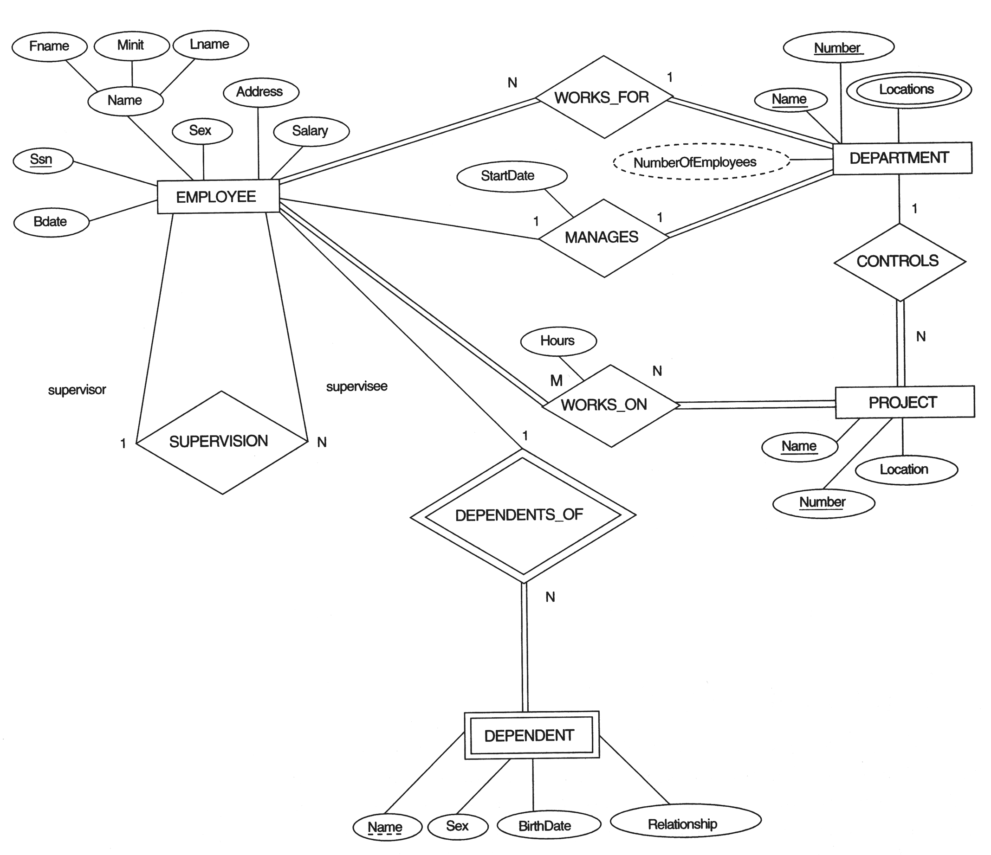
EXAMPLE: from
Elmasri& Navathe
fig 3.2

Slide 15
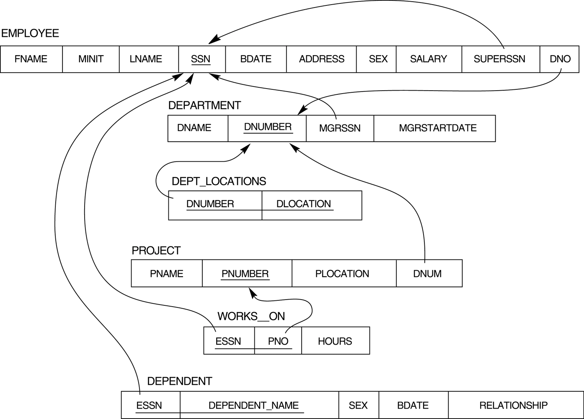
Result of mapping the COMPANY ER schema into a relational schema.

Slide 16
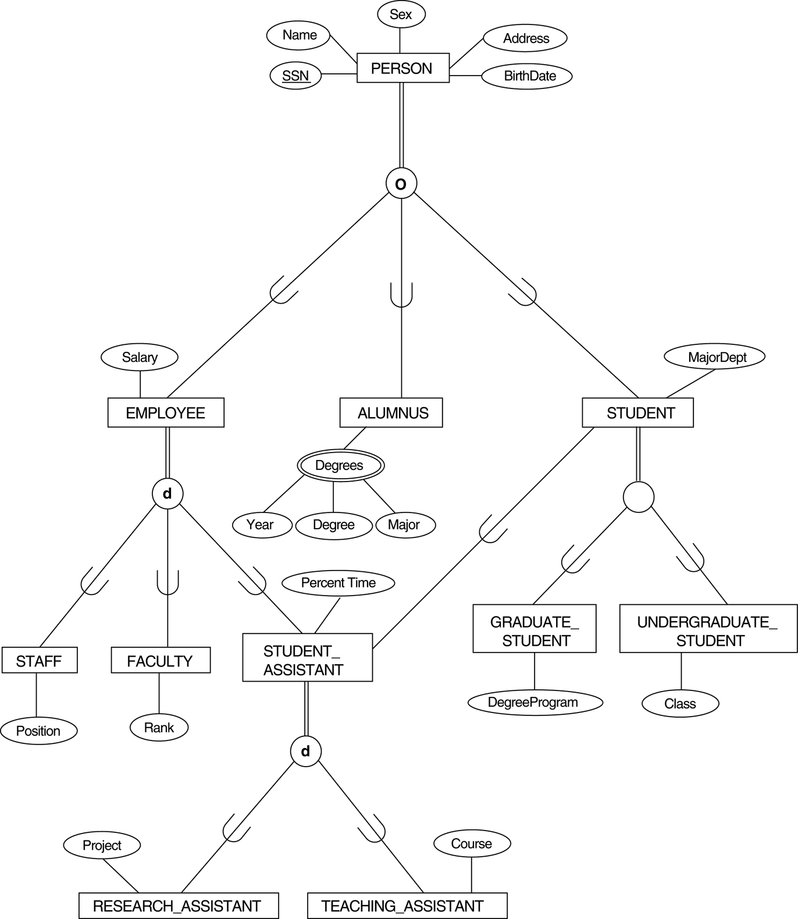
EXAMPLE with ISA
from
Elmasri& Navathe
(fig 4.7)
overlap (=non-disjoint)
{disjoint,
total}

Slide 17
Sample analysis
Recall the three techniques taught:
a table per class
merge subclass tables up into superclass
collapse superclass table down into subclasses
representing Person and its subclasses
subclasses overlap, so (3) is not good bec. of duplication;
because many instances only in one subclass, and Students may not have a majorDept (so this would be null), technique (2) not so good
so use (1)
representing Student and its subclasses
can use technique (3)
Final solution:
Person(ssn,name,sex,address,birthdate)
Employee(ssn,salary)
Alumnus(ssn,degrees)
GradStd(ssn,majorDept,degreeProgr)
UndGradStd(ssn,majorDept,class)
foreign key
(ssn) referencing
Person

Slide 18
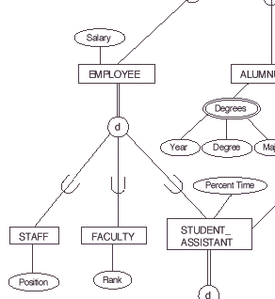
(* Extending previous diagram with Emp subclasses)
Using it on Employee, would yield
Emp(ssn,salary,position,rank, percentTime)
Would be good if lots of overlap between Staff, Faculty and SA and position, rank, percentTime are non-null for their respective subclasses.

Slide 19
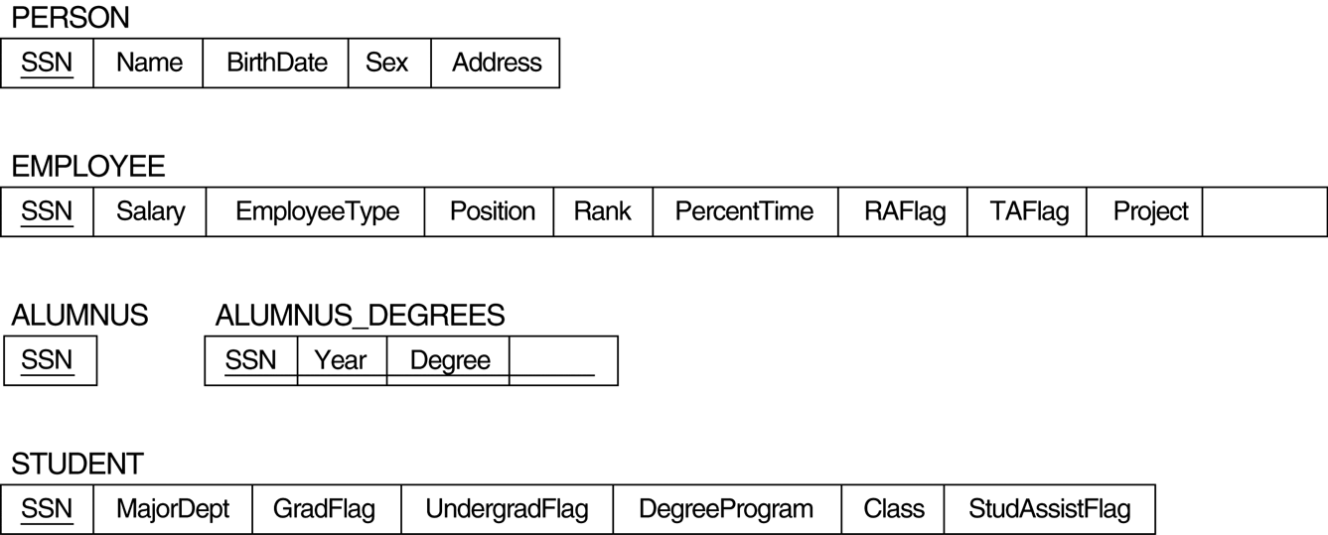
(** Elmasri & Navathe solution to whole picture) - discussed in their book, and uses additional rules (boolean flags ) - this is only for advanced students

